Slide 1
EatSmart
Student: Serbanescu Radu Constantin
Coordinating professor: Rusu Andrei

Slide 2
Presentation structure
Short description
Presentation content
Demonstration
Conclusion
Thanks and regards
Technological details

Slide 3
Short description
EatSmart is a website application for a restaurant that allows creation of food orders, updating the information presented on the website, and confirming the orders sent to the business.
EatSmart will provide restaurants with an application that will reduce the time and money spent on creating their own website, being provided with an easy-to-use base.

Slide 4
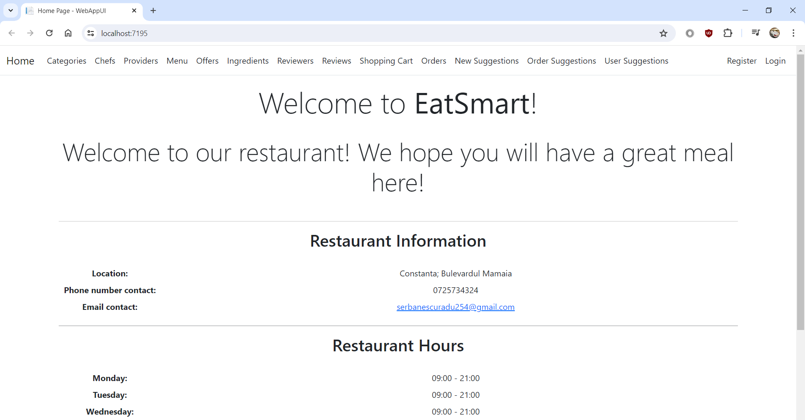
Customer account
Customers can see the information related to the menu and the food offered (for example: ingredients, calories, allergens, etc.), offers and suggestions. Also, they can make online orders, which will eventually be used in creating suggestions for customers.
Some features (shopping cart, orders, suggestions) are accessible only while logged in.

Slide 5
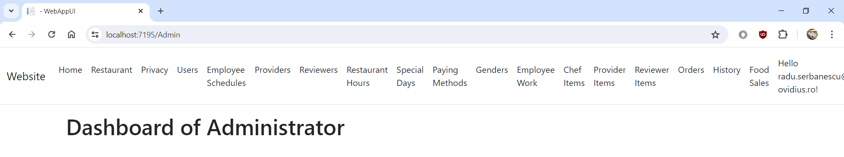
Administrator account
The administrator can change information on the website, whether it is related to the restaurant, its employees, or the companies working with the business, like its providers.

Slide 6
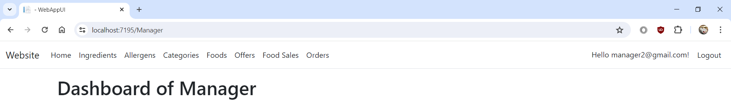
Manager account
The manager can add and modify offers, allergens, and other information related to the food offered by his company for the restaurant. They can also see how well the items sell.

Slide 7
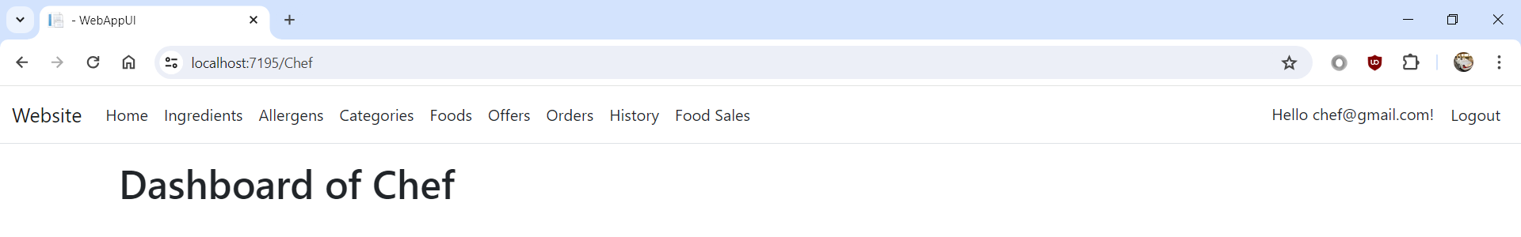
Chef account
The chef can add and modify ingredients, allergens, and other information related to the food created by himself for the menu. They can also see how well the items sell.

Slide 8
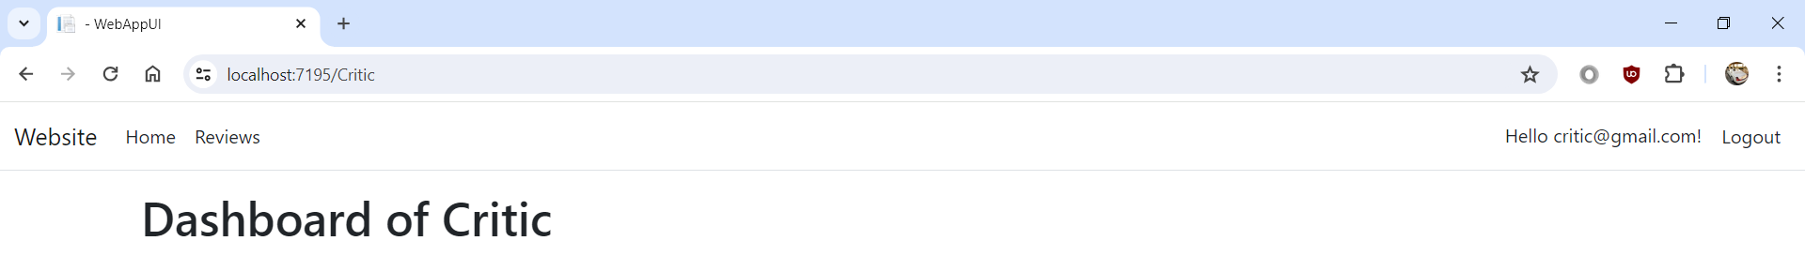
Critic account
The critic can add reviews of the restaurant's food items in the name of a company.

Slide 9
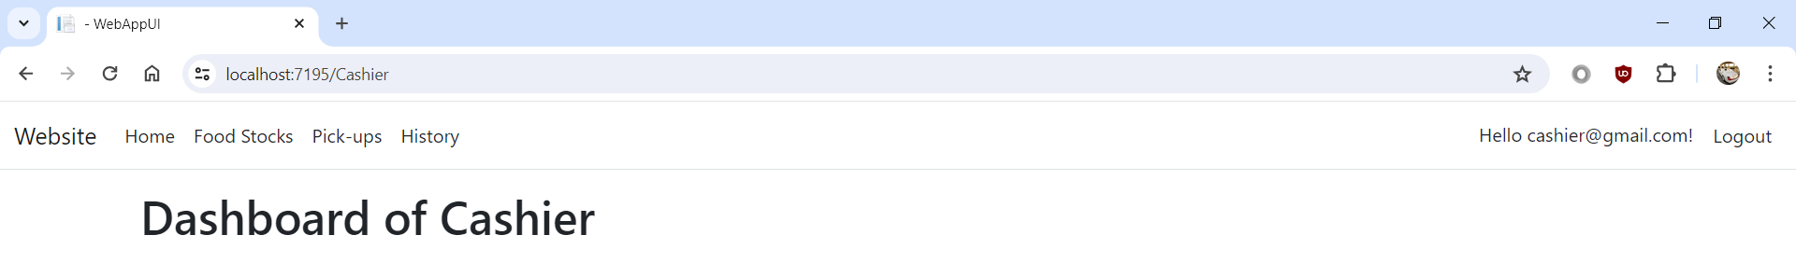
Cashier account
The cashier is in charge of confirming online pickup orders and updating food stocks on the website.

Slide 10
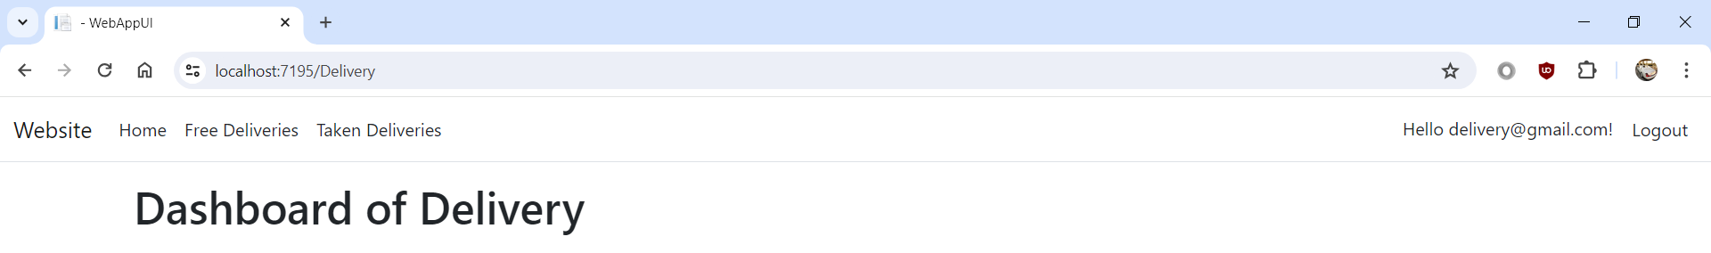
Delivery agent account
The delivery agent handles online deliveries, being able to choose which orders they will deliver and confirm on the website.

Slide 11
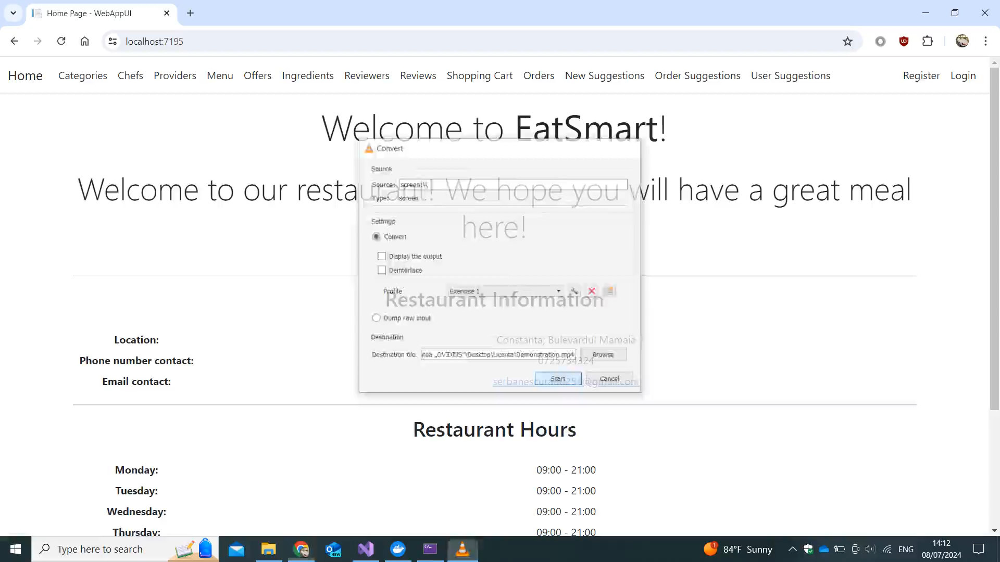
Demonstration

Slide 12
Conclusion
The EatSmart application is a website that deals with a restaurant's menu, customer orders (their creation and delivery), customer suggestions, restaurant food management, and the organization of employees and people associated with the restaurant.
Due to its customizable nature, it can be offered to multiple restaurants that want to create their own website, but lack the skills and knowledge to do so.

Slide 13
Thanks and regards
I want to thank Rusu Andrei for helping me with this project.
I want to thank every professor I had for helping me learn so many things during my 3 years at the university.

Slide 14
Technological details
Concepts used: Model-View-Controller, relational database
Programming languages: C# (main language used), CSS, HTML, Javascript
Operating system used: Windows 10
Applications used: Microsoft Visual Studio (for writing the code and executing the program), Docker Desktop (for the container used by the application), Azure Data Studio (for viewing the data from the container), SendGrid (for sending account confirmation emails from the website), Google Cloud (for external authentication on the website), QRCode.js (for generating QR codes in the application)

